Slide 1


RIMBERIO CO
CARINOSA
Kurt Daniel Cano
Joshua Gabriel Dantes
Gian Higino Fungo
Christian Serrano
Rodel Sustiguer
Cedric Torres
WEEK 4

Slide 2

Carinosa
The "Carinosa" is a traditional Filipino dance and is considered the national dance of the Philippines. Its name is derived from the Spanish word "cariñosa," which means "affectionate" or "loving."

Slide 3
Movement Skills involved in Carinosa
Locomotor Skills: These are basic movement patterns that provide the foundation for the dance.
Walking and Stepping: The basic step patterns in Carinosa.
Hopping: Occasional hops or light jumps are incorporated into the dance.
Non-locomotor Skills: Movements that are done without traveling or shifting the body's position in space.
Twisting: Rotation of the body or parts of the body, such as turning the waist or wrist.
Bending: Flexion movements, especially in the upper body.
Stretching: Extension of arms or legs.
Swinging: Fluid, pendulum-like movements, especially with the arms.
Manipulative Skills: These involve handling props, which in Carinosa would be fans and handkerchiefs.
Waving: Moving the handkerchief or fan in a fluttering motion.
Tossing and Catching: Some variations of the dance might involve playful tossing and catching of the handkerchief.
Twirling: Rotating the handkerchief by its corner or the fan in hand.
Balance and Stability: Holding certain positions or moving in specific ways without losing balance.
Static Balance: Holding a pose, often during moments of pause in the dance.
Dynamic Balance: Maintaining balance while moving, turning, or hopping.

Slide 4
Fitness Benefits
Cardiovascular Fitness: Like many dances, the Carinosa can increase the heart rate, especially during faster-paced sections or when performed continuously. Regular practice can help improve cardiovascular health.
Muscle Toning and Strength: The various movements, especially the lower body steps and upper body gestures, engage and tone muscles. Legs, calves, and the core are particularly worked due to the stepping, balancing, and turning actions.
Flexibility: The dance involves a range of movements, including bending, reaching, and turning, which can help improve flexibility over time, especially in the spine, hips, and arms.
Balance and Coordination: The Carinosa requires dancers to maintain their balance during turns, hops, and partner interactions. Regular practice can improve balance, agility, and coordination.
Spatial Awareness: Dancing with a partner, and sometimes within a group, necessitates an awareness of one's surroundings. This spatial awareness is crucial to avoid collisions and to move harmoniously with others.
Cognitive Function: Remembering the dance steps, coordinating with music, and interacting with a partner all stimulate the brain, helping improve memory and cognitive function.

Slide 5
Dietary Goals
In order to perform well in any dance, one must be meeting the necessary macro nutrients required in order to have enough energy and to be able to recover well enough when dancing.
Regularly hydrating is also advised when doing a physically demanding activity such as dancing

Slide 6
The following nutrients are recommended for anyone looking to perform optimally in dances:
Carbohydrates: The primary source of energy for dancing and other aerobic activities. Eating a balanced amount of carbohydrates can help maintain energy levels during practice and performance.
Protein: Important for muscle repair and growth. After intensive dance practices, protein can help in muscle recovery.
Healthy Fats: Sources like avocados, nuts, and olive oil can provide sustained energy and are essential for overall health.
Vitamins and Minerals: To support overall health, especially bone health and muscle function. Calcium and Vitamin D are particularly important for bone health, while magnesium and potassium can support muscle function.

Slide 7









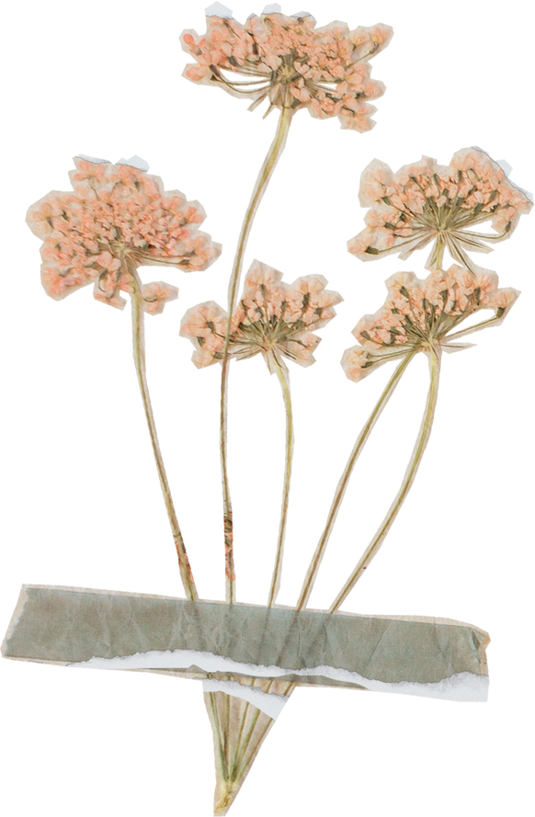
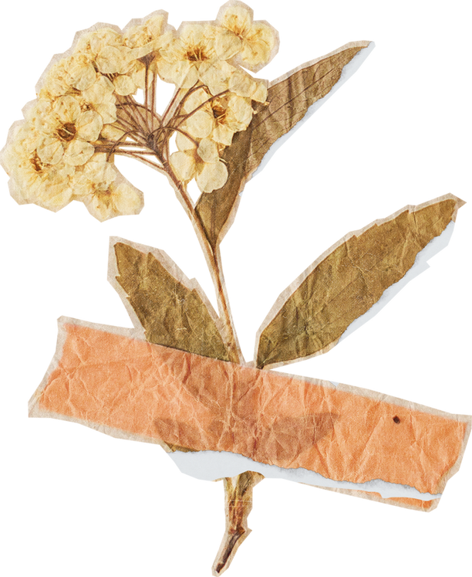
History of Carinosa
Week 5

Slide 8

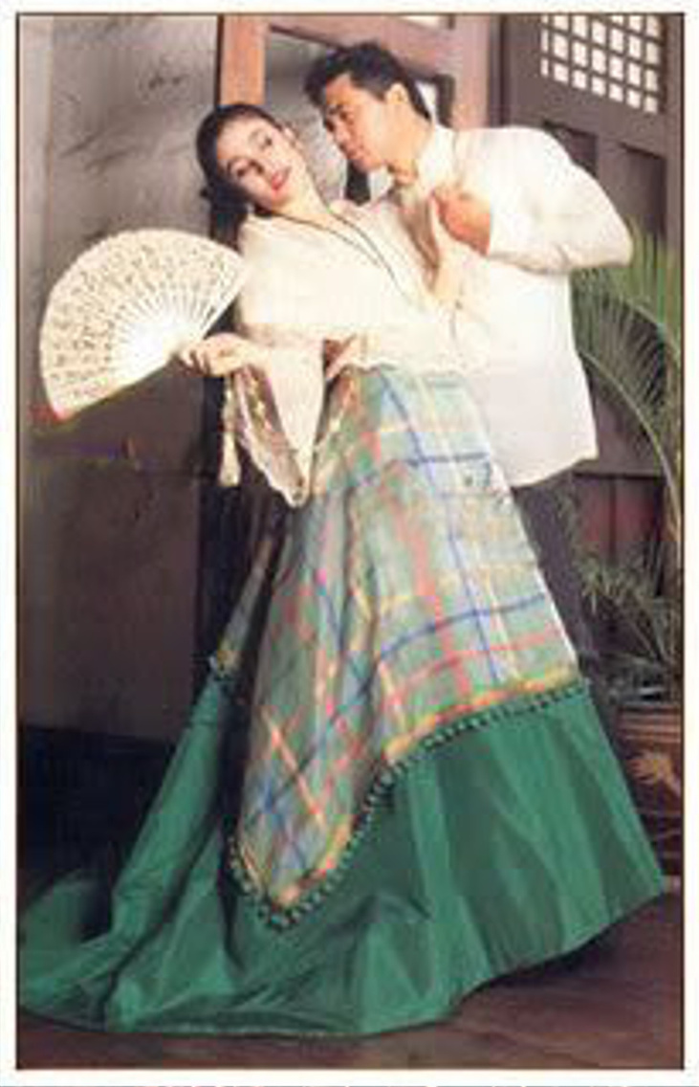

Carinosa
Representing the courting phase of a romantic relationship, the cariñosa (which means “affectionate one”) is a Filipino folk dance that emerges from Panay, the Visayas and the Bicol region. With historical origins dating back to the Spanish colonization era, the cariñosa displays the deep hispanic cultural influences in the Philippines.

Slide 9
Carinosa
The carinosa is a popular folk dance that was introduced to the country by the Spaniards when they arrived in the 16th century. It belongs to the Maria Clara suite of the of the Philippine folk dances. These are so named in honour of Maria Clara,who was the main character in Jose Rizal's novel Noli Me Tangere, about the colonisation of the Philippines by the Spanish. In it, Maria Clara is portrayed as a noble and loyal woman.

Slide 10
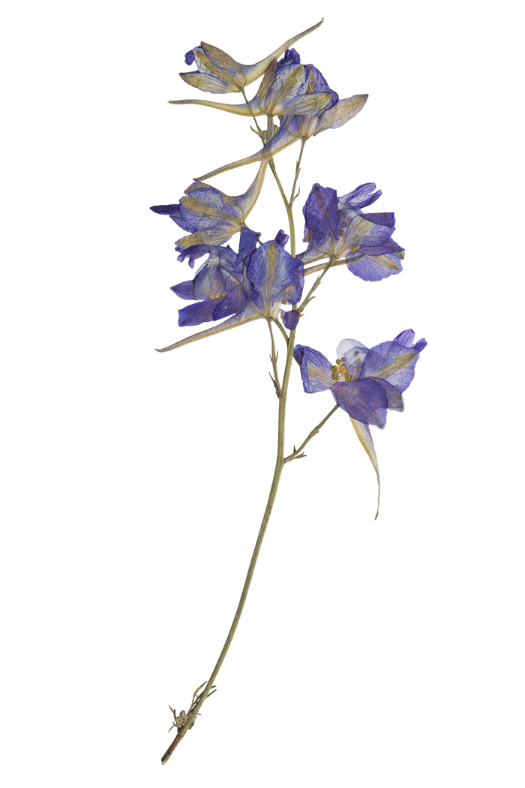



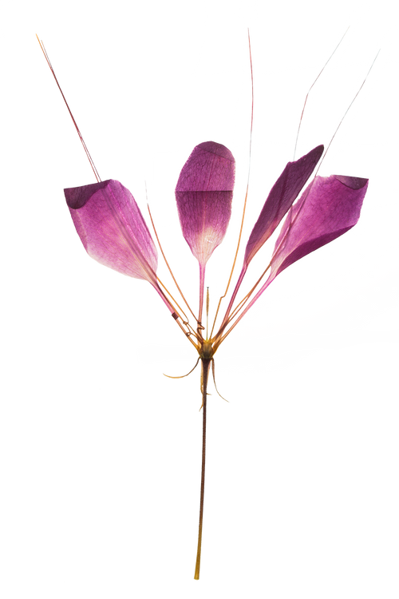
Purpose of the Dance
The carinosa is a much-loved folk dance in the Philippines. Spanish in origin, it is regarded as a national dance by scholars, and the characteristic shy behavior of the female dancer is said to represent the mannerisms of Philippina women.

Slide 11
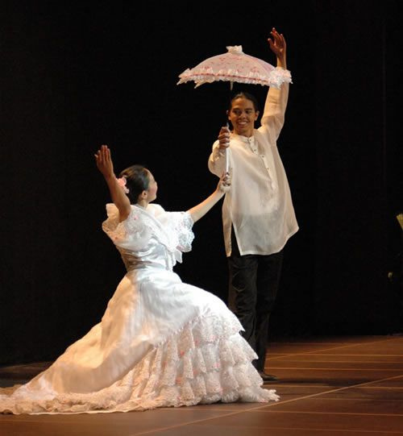
Carinosa outfits

Slide 12

Example of Carinosa

Slide 13
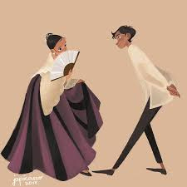
Figures of Cariñosa

Slide 14
Figure 1
"Three Steps and Point"

Slide 15
Figure 2
"Pointing"

Slide 16
Figure 3
"Back-to-back"

Slide 17
Figure 4
"Hide-and-seek with Fan"

Slide 18
Figure 5
"Kneeling and Fanning"

Slide 19
Figure 6
"Hide-and-seek with Handkerchief"

Slide 20
Figure 7
"Flirting with Handkerchief"

Slide 21
Figure 8
"Flirting"

Slide 22
Full Dance

